Slide 1
Kinematics of 3R or RRR Planar Robotic Arm
Presented by: Sourav Kumar

Slide 2
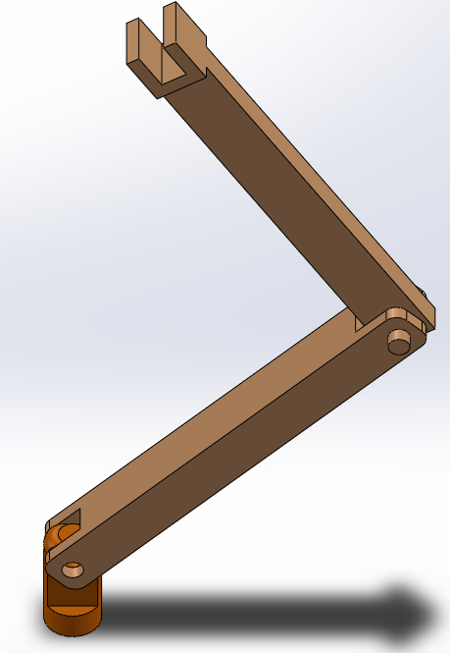
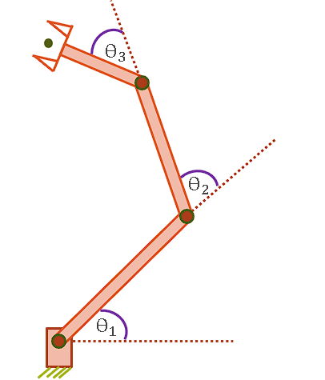
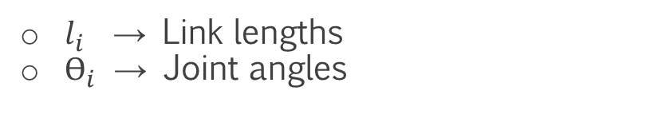










Forward Kinematics
All three joints are revolute.
Double hash marks indicates all 3 axes are parallel.
$l_{i }$→ Link lengths
$ϴ_{i}$ → Joint angles
$$X_{4}$$
$$X_{3}$$
i = 1, 2, 3
$$Y_{4}$$
$$Y_{3}$$
$$X_{2}$$
$$Y_{0}$$
$$Y_{2}$$
$$Y_{1}$$
$$X_{1}$$
$$X_{0}$$
CAD Model
Schematic Diagram
Assigning Frames
Sourav Kumar

Slide 3

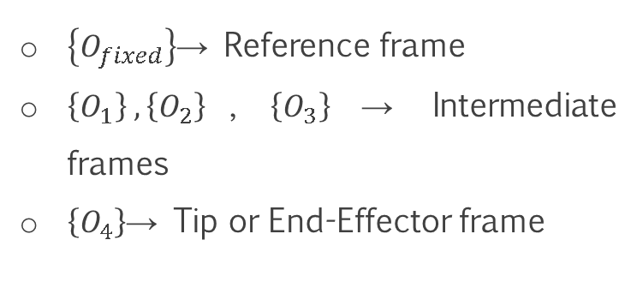


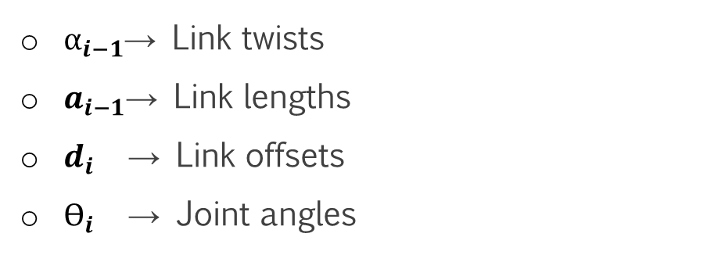



DH Parameters
$$\left\{O_{4}\right\}$$
i | $$α_{i−1}$$ | $$a_{i−1}$$ | $$d_{i}$$ | $$ϴ_{i}$$
1 | 0 | 0 | 0 | $$ϴ_{1}$$
2 | 0 | $$l_{1}$$ | 0 | $$ϴ_{2}$$
3 | 0 | $$l_{2}$$ | 0 | $$ϴ_{3}$$
4 | 0 | $$l_{3}$$ | 0 | 0
$$\left\{O_{3}\right\}$$
$$\left\{O_{2}\right\}$$
$\left\{O_{fixed}\right\}$→ Reference frame
$\left\{O_{1}\right\} ,\left\{O_{2}\right\}$, $\left\{O_{3}\right\}$→ Intermediate frames
$\left\{O_{4}\right\}$→ Tip or End-Effector frame
$α_{i−1}$→ Link twists
$a_{i−1}$→ Link lengths
$d_{i}$ → Link offsets
$ϴ_{i}$ → Joint angles
$$\left\{O_{1}\right\}$$
$$\left\{O_{fixed}\right\}$$
Link Frame Assignment
Sourav Kumar

Slide 4
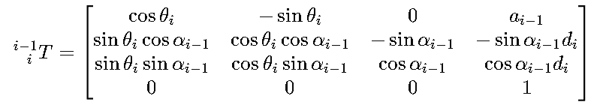
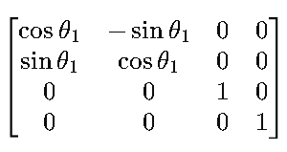
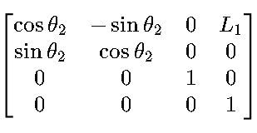
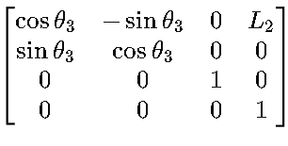
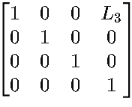

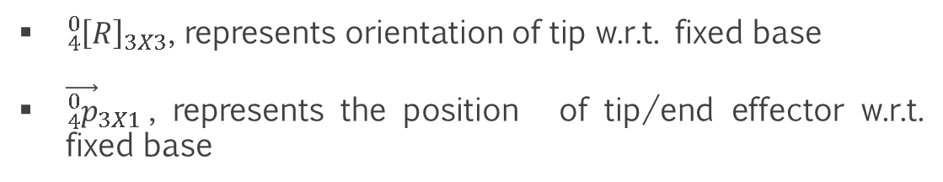
Transformation of frames
${}_{i}^{i−1}{\left[T\right]}$ = ${\text{Screw}}_{X}(a_{i−1}$, $α_{i−1})$ ${\text{Screw}}_{Z}(d_{i}$,$ϴ_{i})$
${}_{4}^{0}{\left[T\right]}$ = ${}_{1}^{0}{\left[T\right]}$ ${}_{2}^{1}{\left[T\right]}$ ${}_{3}^{2}{\left[T\right]}$ ${}_{4}^{3}{\left[T\right]}$
= $\left[\begin{matrix}{{}_{4}^{0}{\left[R\right]}}_{3X3} & {\vec{{}_{4}^{0}p}}_{3X1} \\ 0_{3X1} & 1\end{matrix}\right]$
=
${{}_{4}^{0}{\left[R\right]}}_{3X3}$, represents orientation of tip w.r.t. fixed base
${\vec{{}_{4}^{0}p}}_{3X1}$, represents the position of tip/end effector w.r.t. fixed base
4 X 4
Sourav Kumar

Slide 5
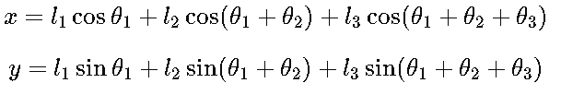
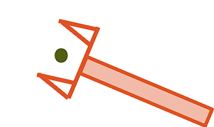
























Inverse Kinematics
Position and orientation of the of the end-effector w.r.t. fixed base.
(x, y, Ø)
$$X_{4}$$
$$ϴ_{3}$$
$$Y_{4}$$
$$ϴ_{3}$$
$$ϴ_{3}$$
$$l_{3}$$
$$X_{3}$$
$$Y_{3}$$
$$ϴ_{2}$$
y
$$l_{2}$$
$$ϴ_{2}$$
$$Y_{2}$$
$$X_{2}$$
$$Y_{0}$$
$$ϴ_{2}$$
Ø
$$l_{1}$$
$$Y_{0}$$
$$ϴ_{1}$$
$$Y_{1}$$
$$X_{1}$$
$$X_{0}$$
$$ϴ_{1}$$
$$ϴ_{1}$$
x
$$X_{0}$$
Kinematic diagram
Link Frame Assignment
Projection of tip/end-effector’s point
Sourav Kumar

Slide 6
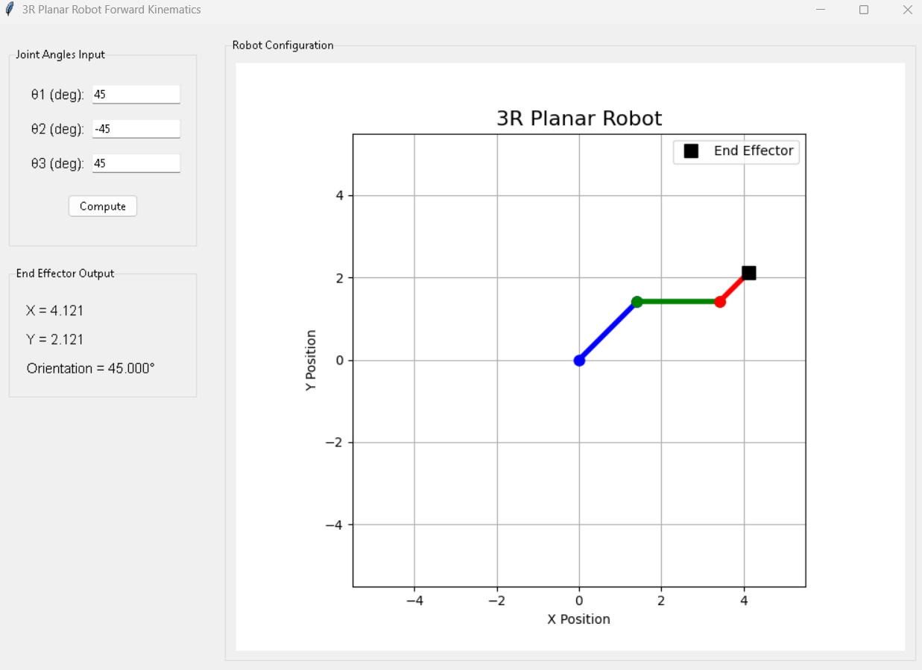
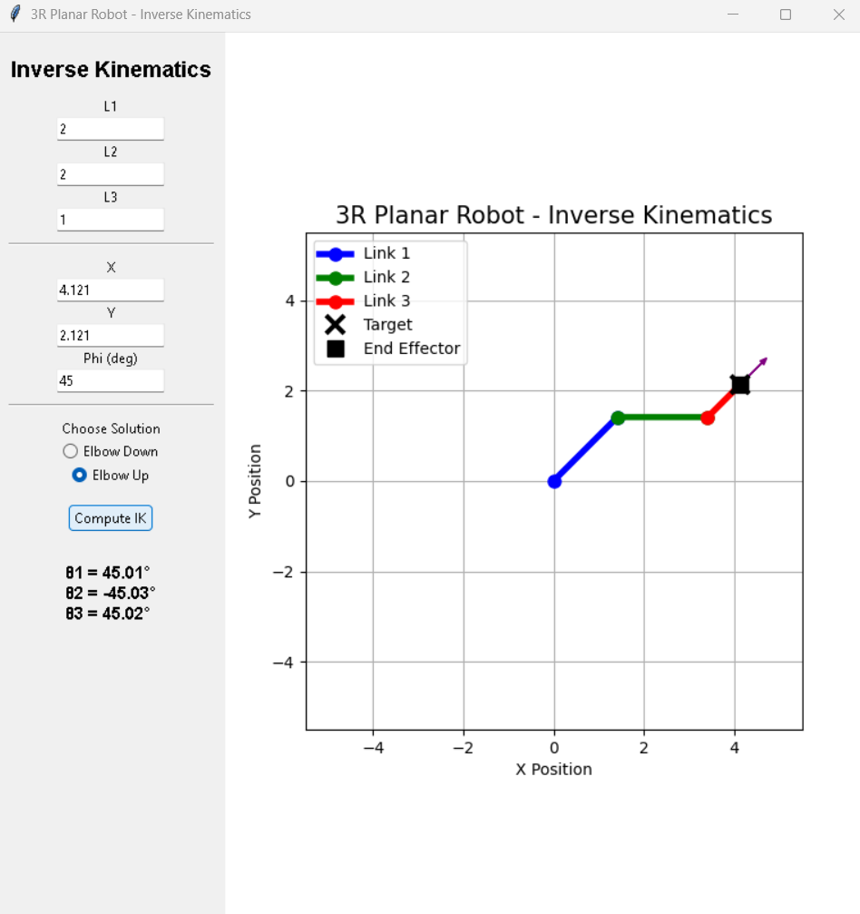
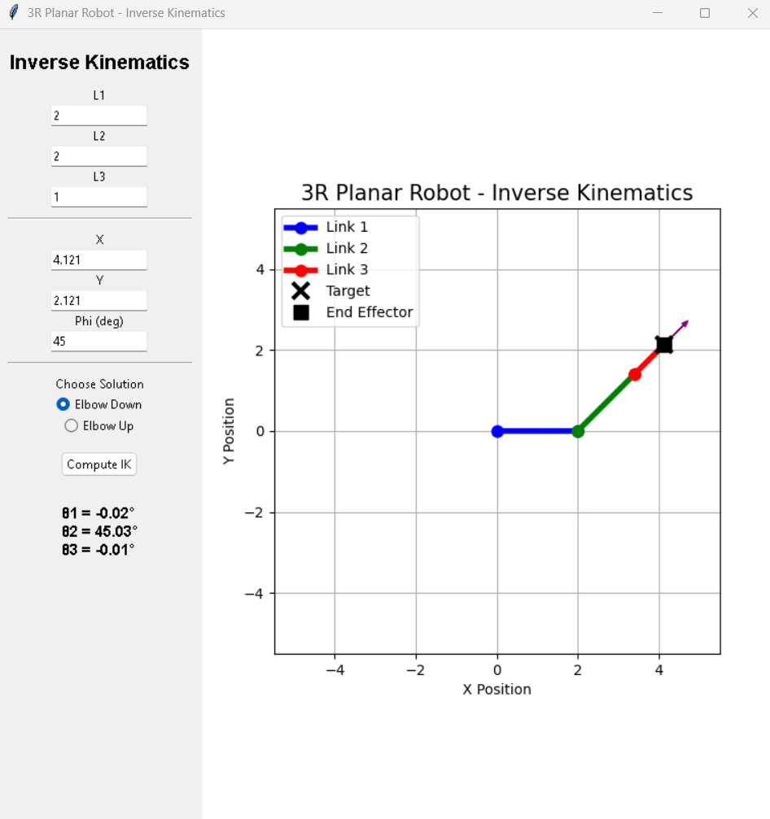
Verification of Kinematics
Sourav Kumar

Slide 7
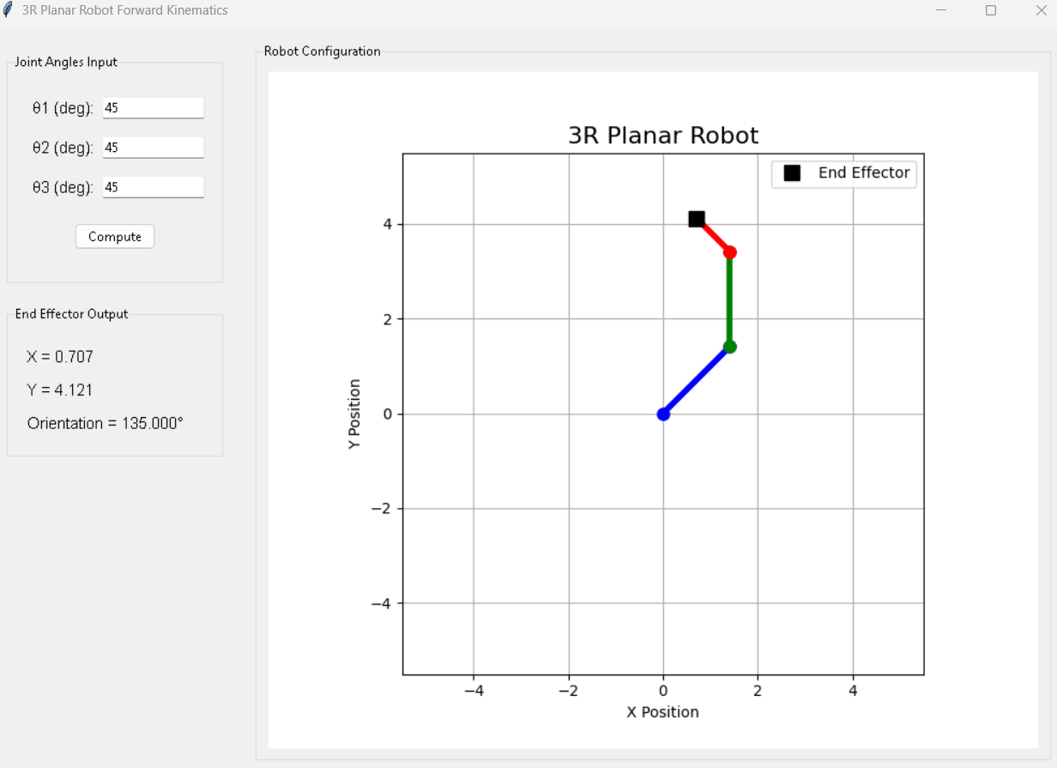
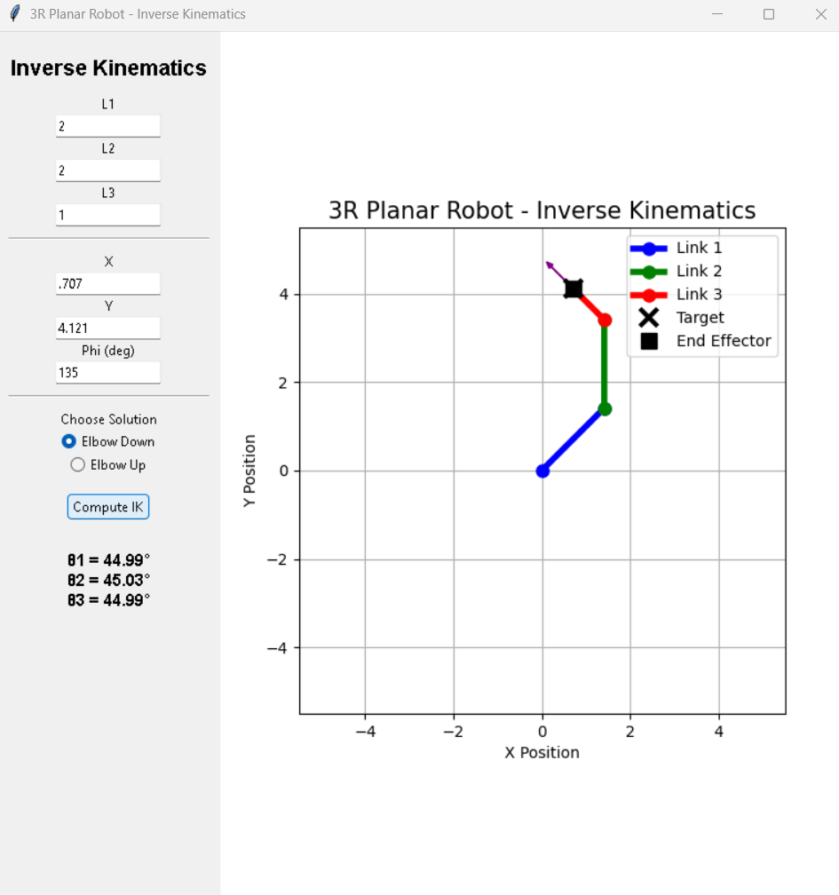
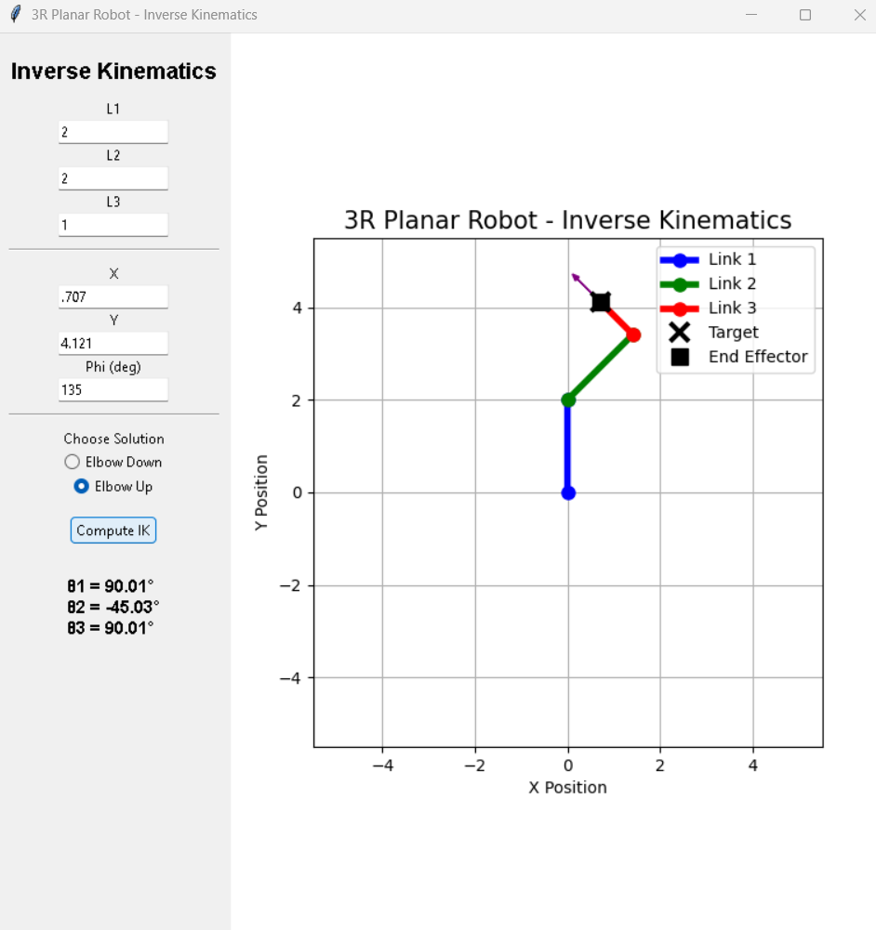
Verification of Kinematics
Sourav Kumar

Slide 8
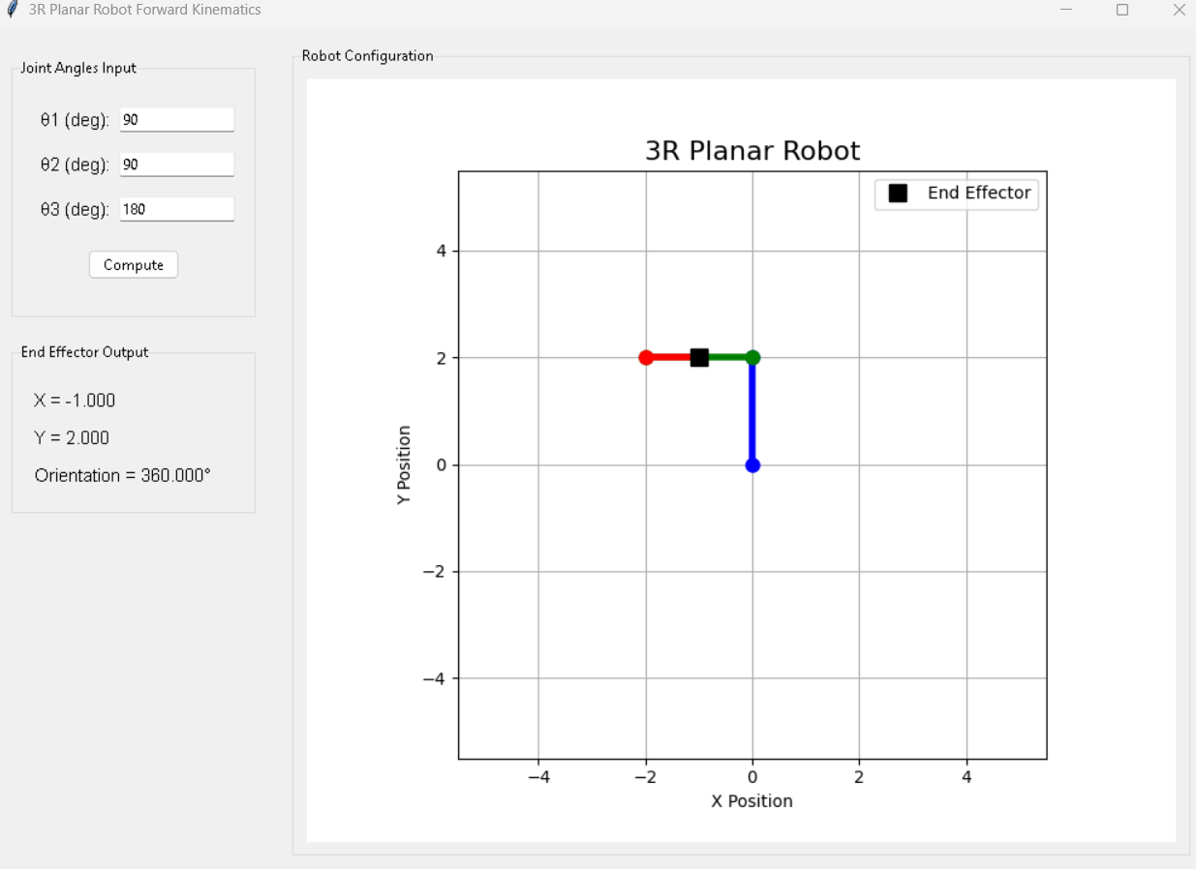
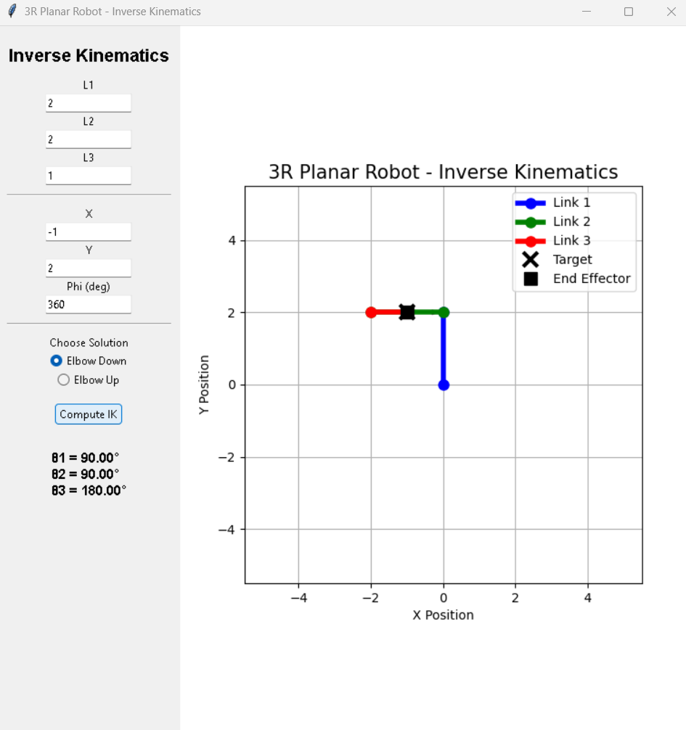
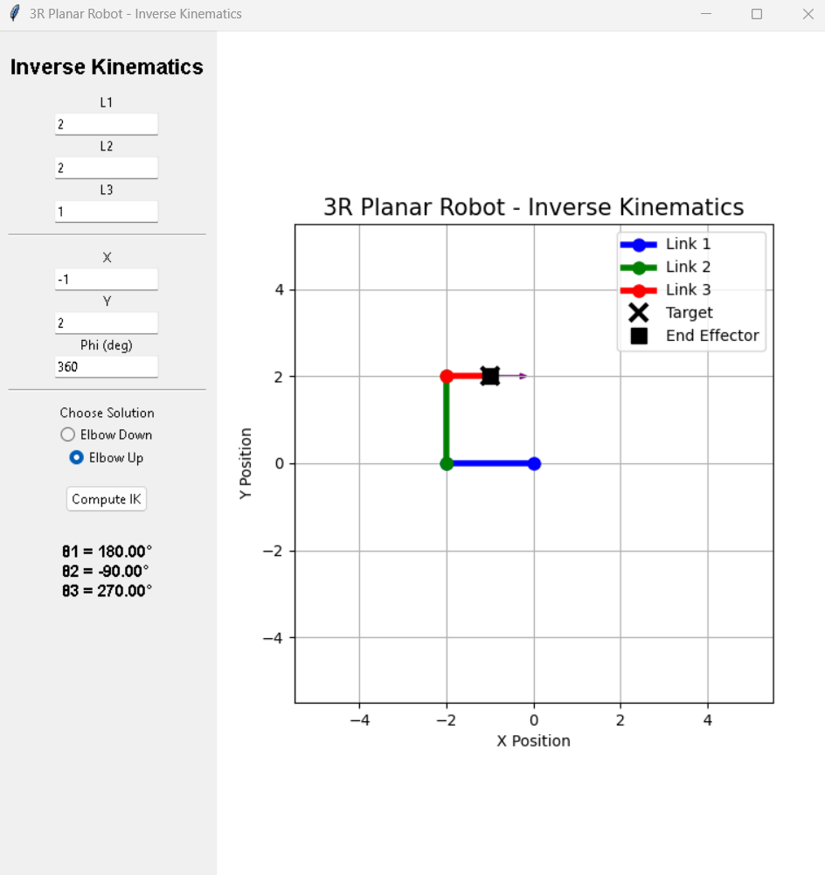
Verification of Kinematics
Sourav Kumar

Slide 9
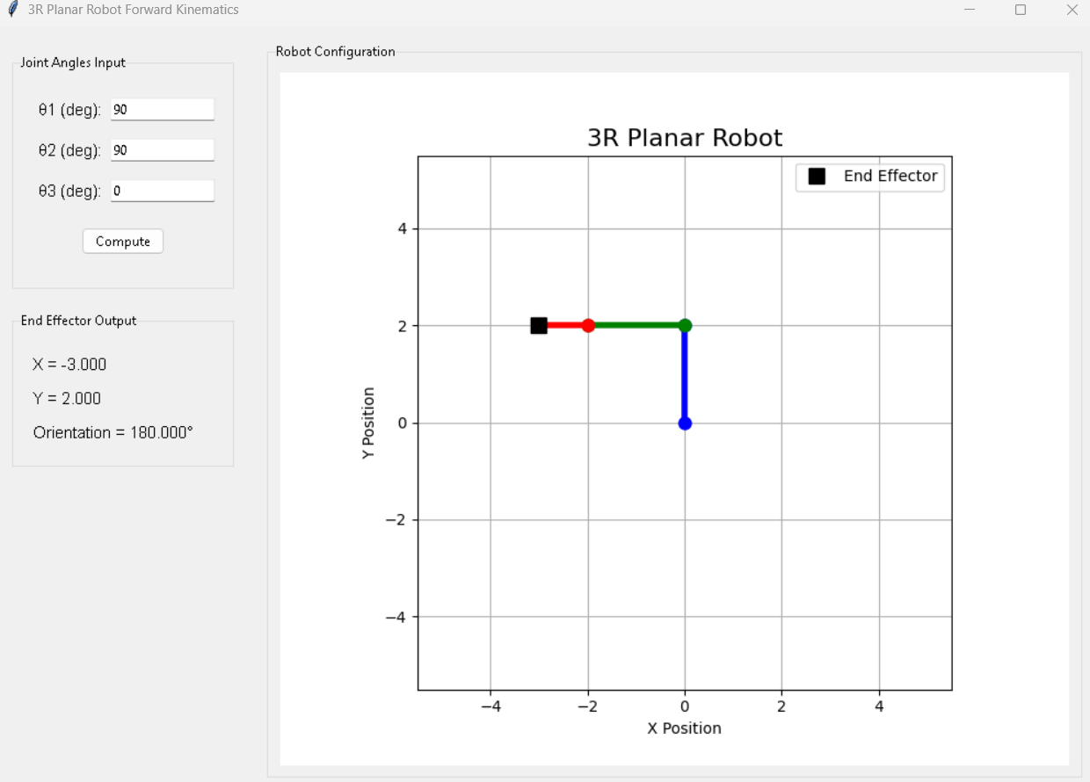
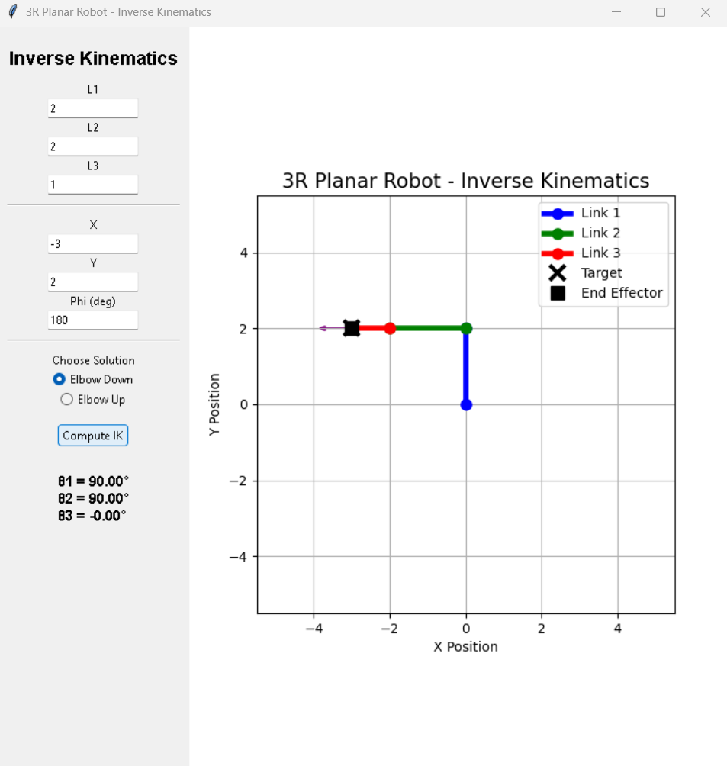
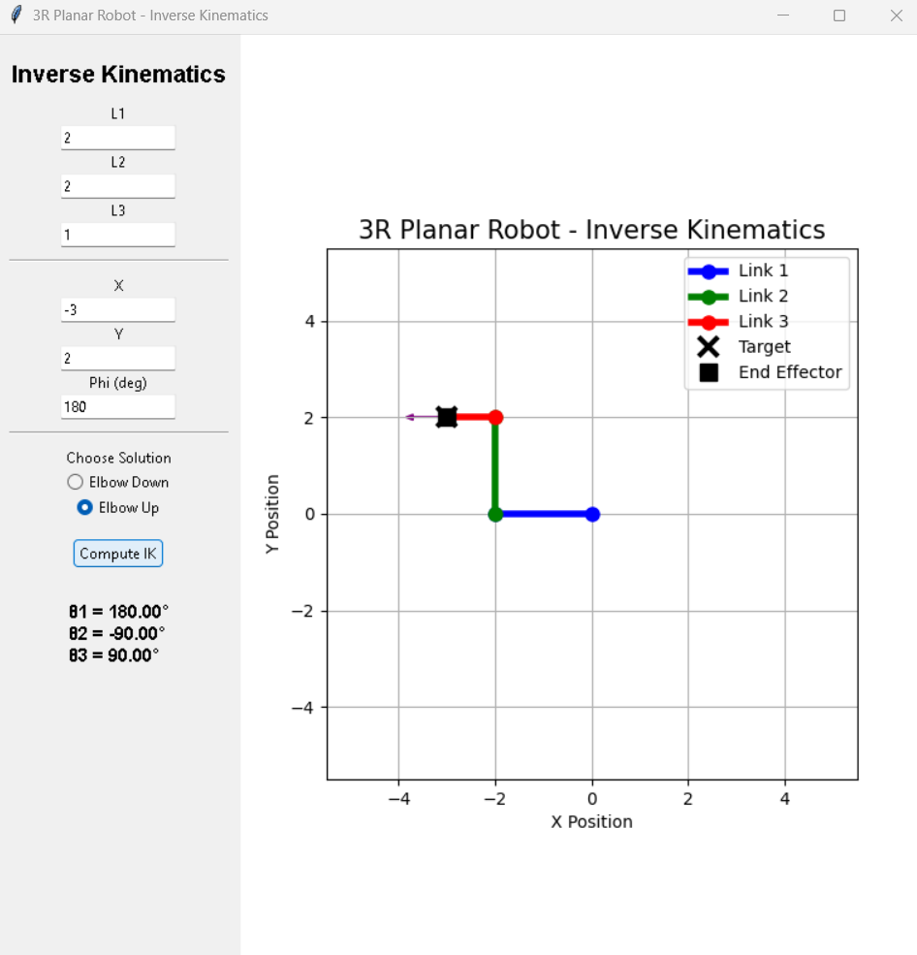
Verification of Kinematics
Sourav Kumar

Slide 10
Thank You
Sourav Kumar

